Slide 1
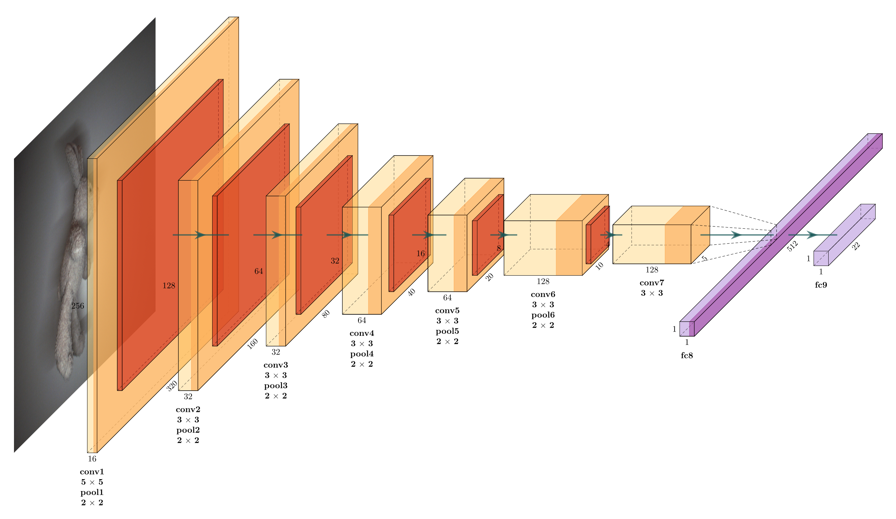
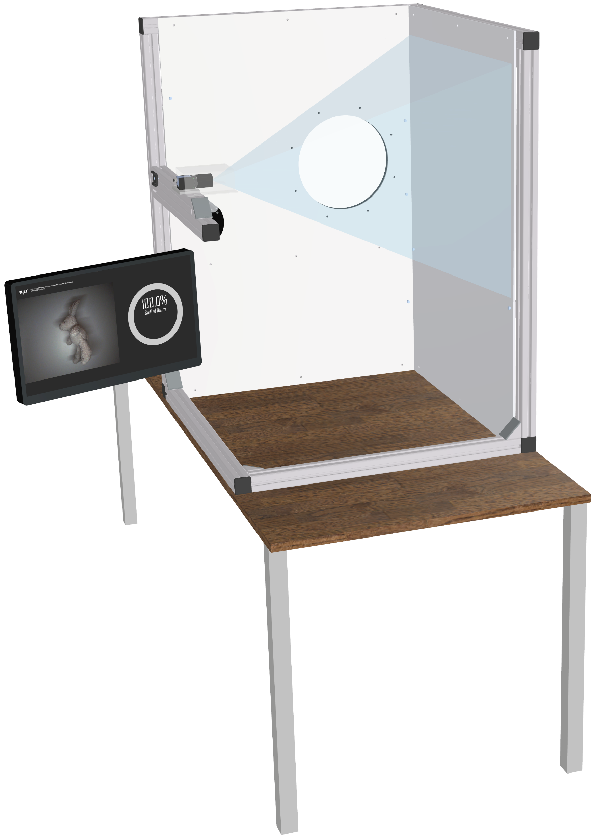
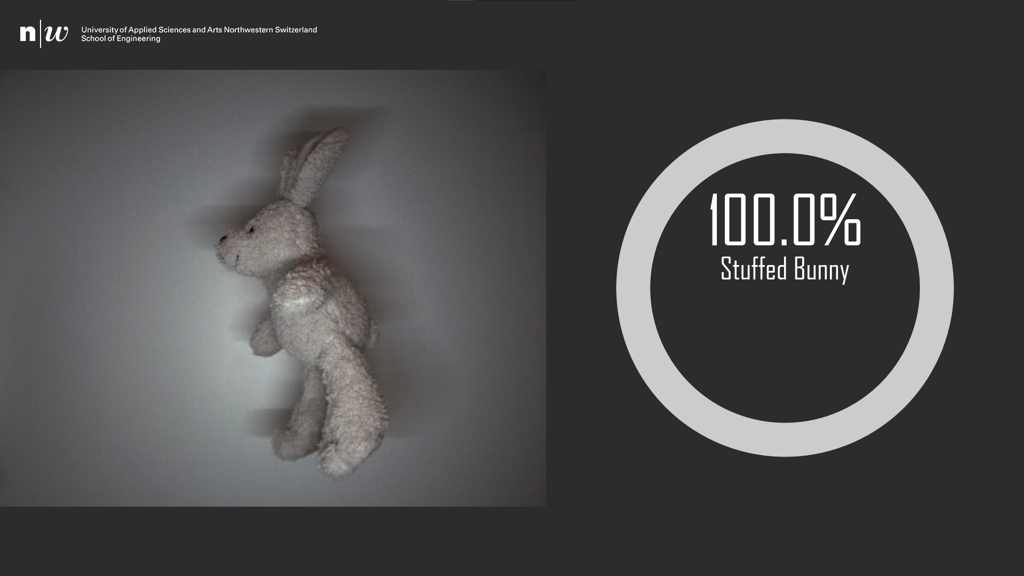
Exhibition No. 012
AI High-Performance Solution on FPGA
Real-time image classification with a convolutional neural network (CNN) using a field-programmable gate array (FPGA) as a hardware accelerator.
Throwing Booth
The throwing booth is constructed from general-purpose aluminium profiles. The white side panel serves as a consistent background for the images. The image acquisition system consists of a Baumer industrial camera combined with a suitable lens. Strong diffuse lighting is used to minimize the required exposure time and to illuminate the side panel as evenly as possible. Finally, a monitor is used to display the detected object.
Architecture of the Convolutional Neural Network (CNN)
CNN
The image classification is done with a deep convolutional neural network. It consists of 15 layers and a total of 1’614’484 trainable parameters.
Camera
Lighting
Results
Accuracy: 97.2 %
Throughput: 41.1 fps
Throwing Booth
User Interface
Degree Program: Electrical Engineering and Information Technology
Students: Nico Canzani, Dominik Müller
Customer: FHNW / Institute for Sensors and Electronics
Expert: Dr. Jürg M. Stettbacher
Coaches: Prof. Michael Pichler, michael.pichler@fhnw.ch
Prof. Dr. Hanspeter Schmid, hanspeter.schmid@fhnw.ch

